Slide 1
Embedded Systems
PWM Interfacing

Slide 2
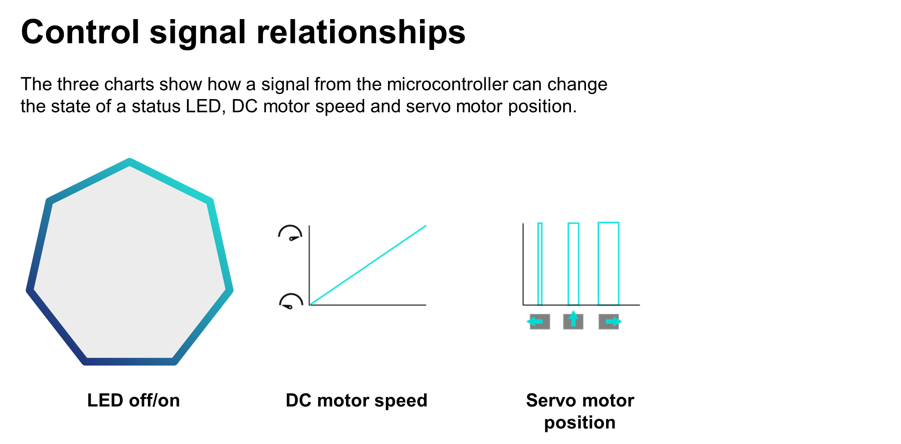

Slide 3
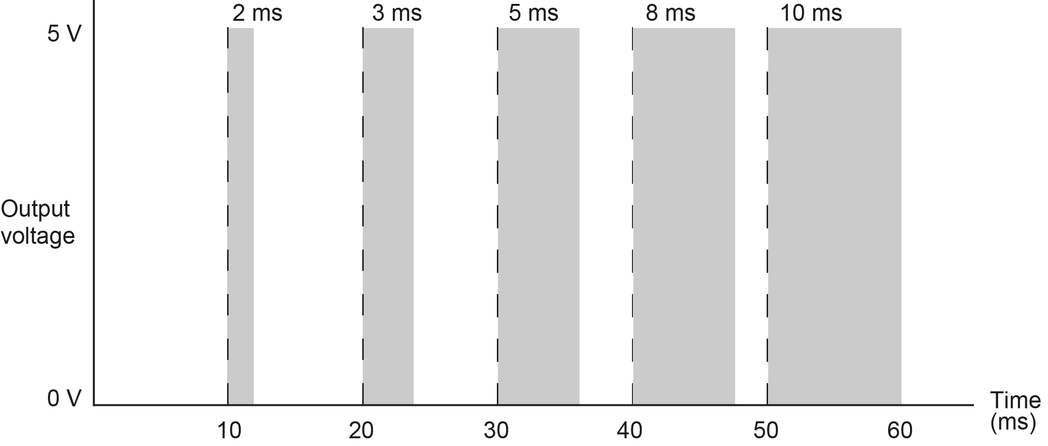
What is pulse width modulation?
What is the frequency of this PWM signal?
Calculate the % duty cycle during each period, and the average voltage this produces each time.
What duty cycle would be needed to create the following average voltages? 1.2 V, 3.5 V, 4.8 V
This controller has 8-bit resolution (0 to 255). What is the resolution of the PWM output, in volts?
Pulse width modulation (PWM) is a form of digital to analogue conversion (DAC).
PWM varies the time for which the output voltage is set high (the duty cycle) in a set frequency. Output devices like DC motors interpret this as the average voltage during each period. The bars in the diagram below show how the pulse widths in this signal vary. Each pulse is 10 ms apart, for example, a 1 ms pulse below would be a 10% duty cycle (1 ms/10 ms).

Slide 4
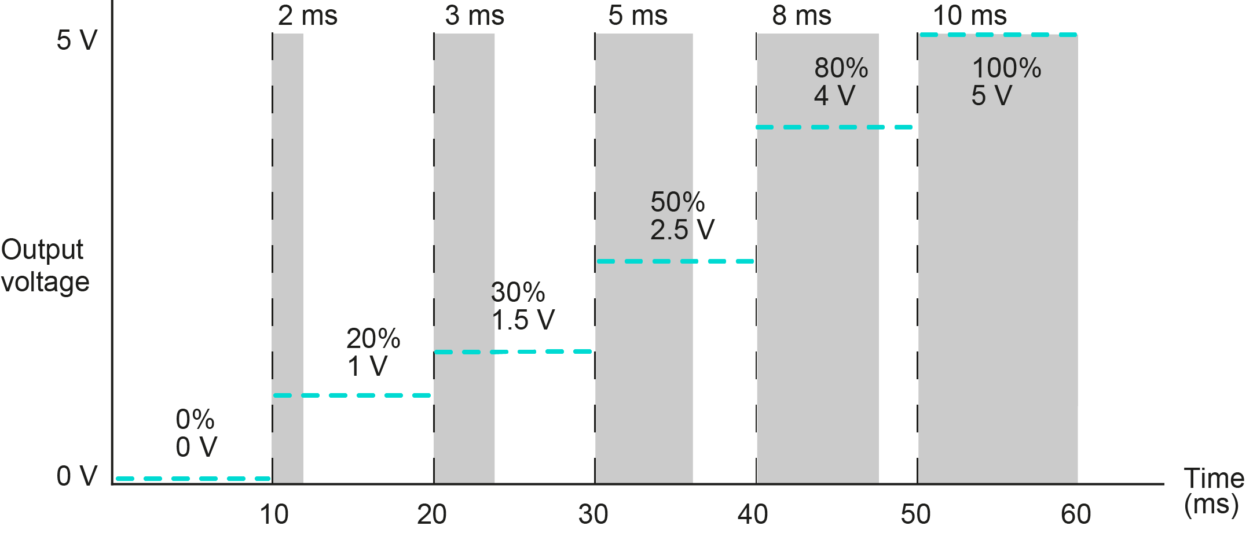
What is pulse width modulation?
What is happening if the duty cycle is set to zero or 100%?
More generally, what is happening if the duty cycle stays the same?
How could PWM control the speed of a motor?
The frequency of the PWM signal is 100 Hz (1/10 ms = 100)
Duty cycles:
1.2 V: 24%, or 2.4 ms (1.2 V/5 V x 100% = 24%)
3.5 V: 70%, or 7 ms
4.8 V: 96%, or 9.6 ms
The resolution of the PWM output is 5 Volts / 256 steps = 0.02 V to 2 decimal places.

Slide 5
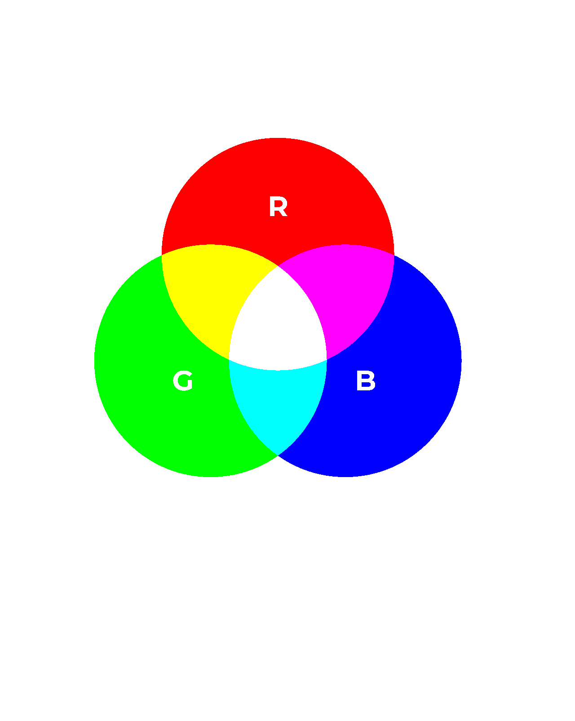

Applying pulse width modulation: RGB LEDs
A CNC machine status light can be red, amber or green.
A microcontroller changes the status of the red, green or blue emitters in an RGB LED.
Each emitter can be on, dimmed (50% duty cycle) or off.
First, think about what PWM signal to each emitter will create a red, yellow or green light. Then, consider whether you need to send a 50% duty cycle signal to the red or green emitter, while leaving the other on 100%, to change yellow to amber. Sketch on the activity sheet what PWM signals would make the light cycle through red, amber and green statuses.

Slide 6
Applying pulse width modulation: DC motors
The CNC tool head motor has an operating speed of 0 to 12,000 rpm.
The microcontroller will operate a higher power PWM circuit to control the motor speed.
This PWM circuit will operate at a frequency of 50 kHz.
Complete the table on the activity sheet to show the duty cycles for a range of tool head motor speeds.

Slide 7
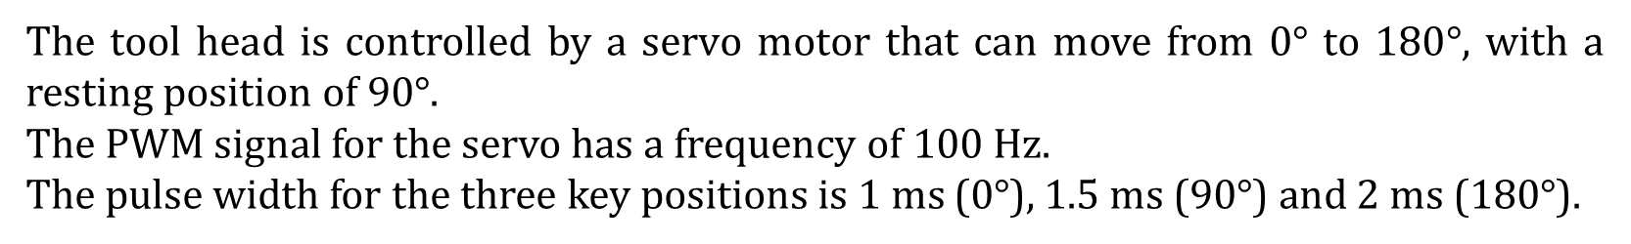
Applying pulse width modulation: servo motors
The tool head is controlled by a servo motor that can move from 0$°$ to 180$°$, with a resting position of 90$°$.
The PWM signal for the servo has a frequency of 100 Hz.
The pulse width for the three key positions is 1 ms (0$°$), 1.5 ms (90$°$) and 2 ms (180$°$).
Calculate the pulse width for the intermediate positions listed on the activity sheet.
If the microcontroller has an 8-bit (256 step) resolution, what is in principle the smallest increment by which the servo motor can rotate?

Slide 8
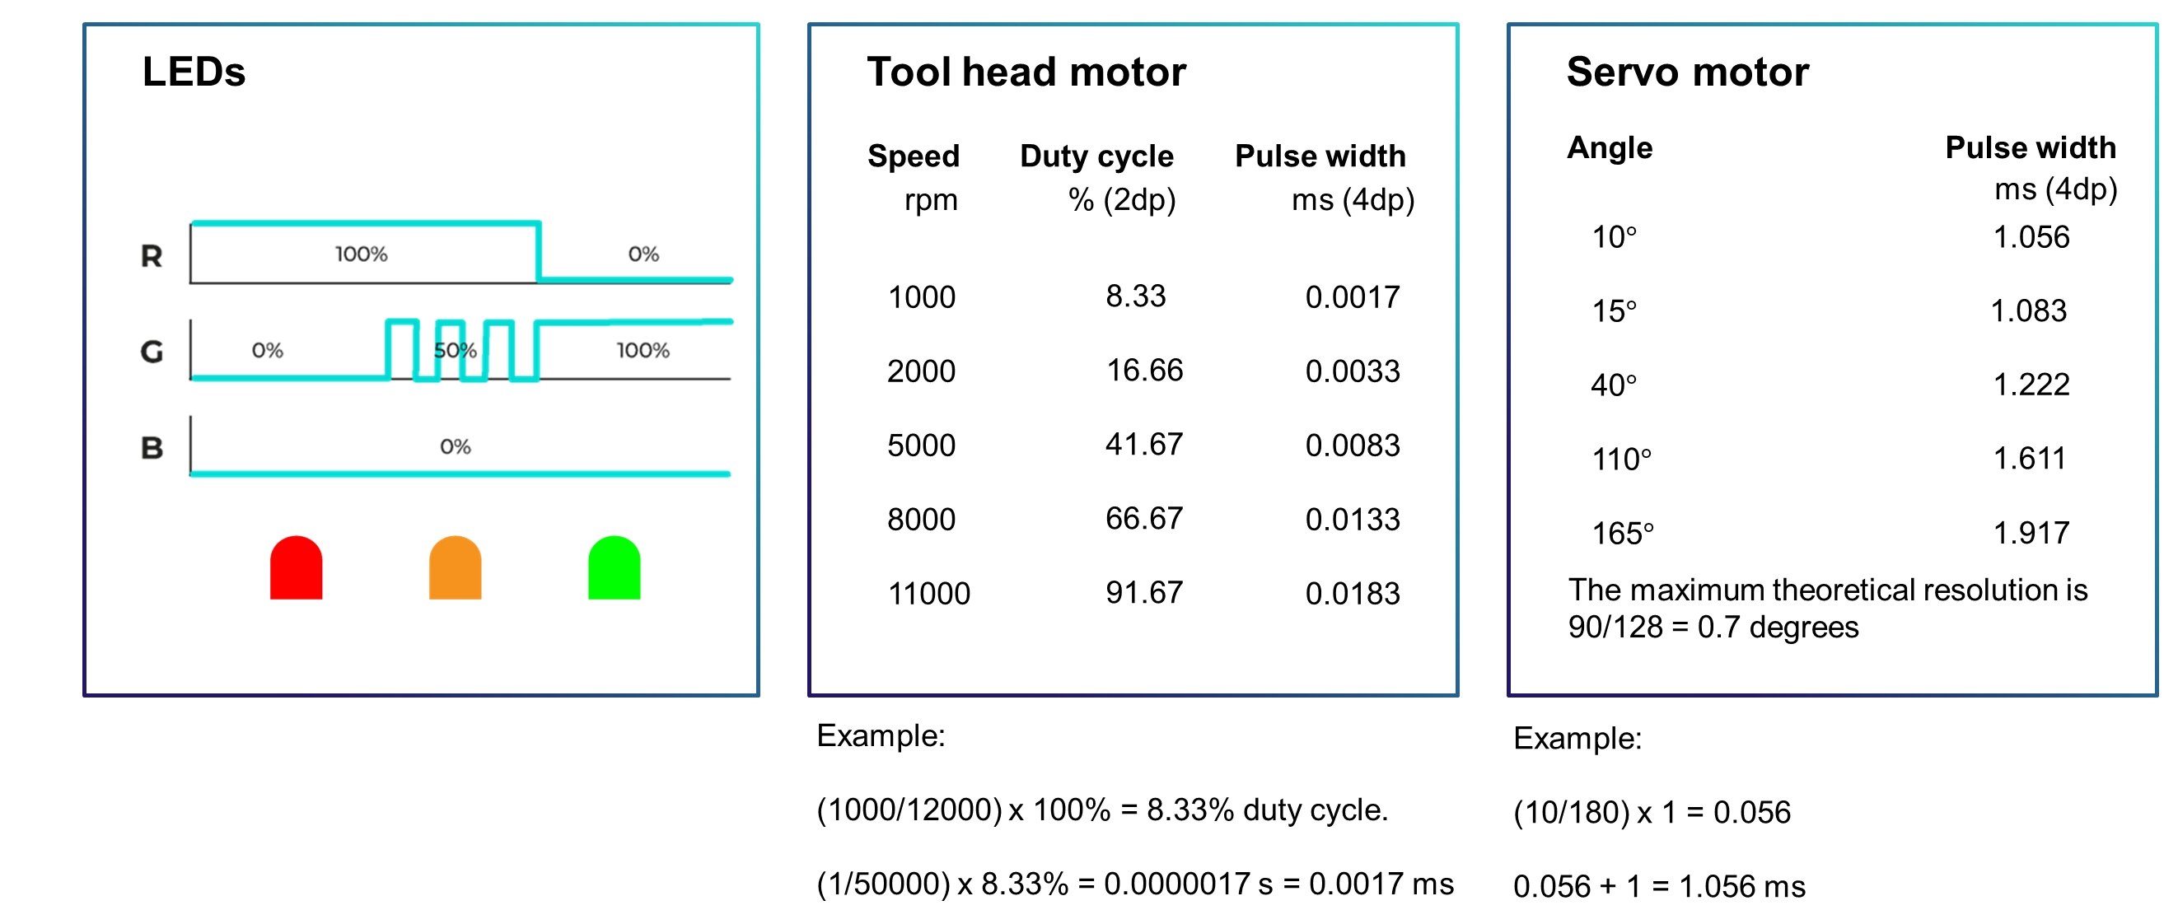

Slide 9
Pulse width modulation
Use Pulse Width Modulation (PWM) to approximate
Digital outputs are capable of 0V or 5V
Over a fraction (t_{on}) of a time period t_{cycle}, keep pin at 5V, the rest of the time, at 0V
Average voltage is proportional to t_{on}/t_{cycle}, called the ‘Duty Cycle’
Application
Identify how PWM can control a range of devices including LEDs, DC motors and servo motors.
Make calculations to generate the right PWM signal to obtain desired results.

Slide 10
Arduino analogWrite( )
analogWrite(pin, value);
0 ≤ value ≤ 255
0% duty cycle --> 0 V --> analogWrite(pin, 0);
100% duty cycle --> 5 V --> analogWrite(pin, 255);

Slide 11
Analog Output Example
const byte ledPin = 3; // red RGB LED on Experimenter
const byte FADE_MAX = 255; // max value for setting duty cycle
const byte FADE_INC = 5; // increment for changing duty cycle
void setup()
{
pinMode(ledPin, OUTPUT);
}
void loop()
{
int fadeValue; // PWM value
// fade in from min to max in increments of 5 points:
for(fadeValue = 0 ; fadeValue <= FADE_MAX; fadeValue +=FADE_INC)
{
analogWrite(ledPin, fadeValue); // sets the value (range from 0 to 255):
}
// fade out from max to min in increments of 5 points:
for(fadeValue = FADE_MAX; fadeValue >= 0; fadeValue -=FADE_INC)
{
analogWrite(ledPin, fadeValue); // sets the value (range from 0 to 255):
}
}
Fade the red LED in, then out
duty cycle is incremented then decremented
256 steps
0% to 100%
fade_example.pde

Slide 12
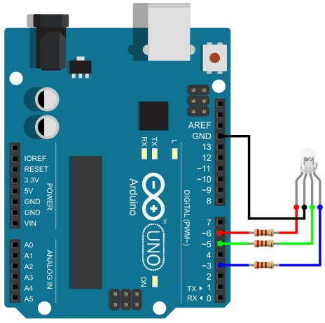
int redPin= 6;
int greenPin = 5;
int bluePin = 4;
void setup() {
pinMode(redPin, OUTPUT);
pinMode(greenPin, OUTPUT);
pinMode(bluePin, OUTPUT);
}
void loop() {
setColor(255, 0, 0); // Red Color
delay(1000);
setColor(0, 255, 0); // Green Color
delay(1000);
setColor(0, 0, 255); // Blue Color
delay(1000);
setColor(255, 255, 255); // White Color
delay(1000);
setColor(170, 0, 255); // Purple Color delay(1000); } void setColor(int redValue, int greenValue, int blueValue) { analogWrite(redPin, redValue);
analogWrite(greenPin, greenValue);
analogWrite(bluePin, blueValue); }

Slide 13
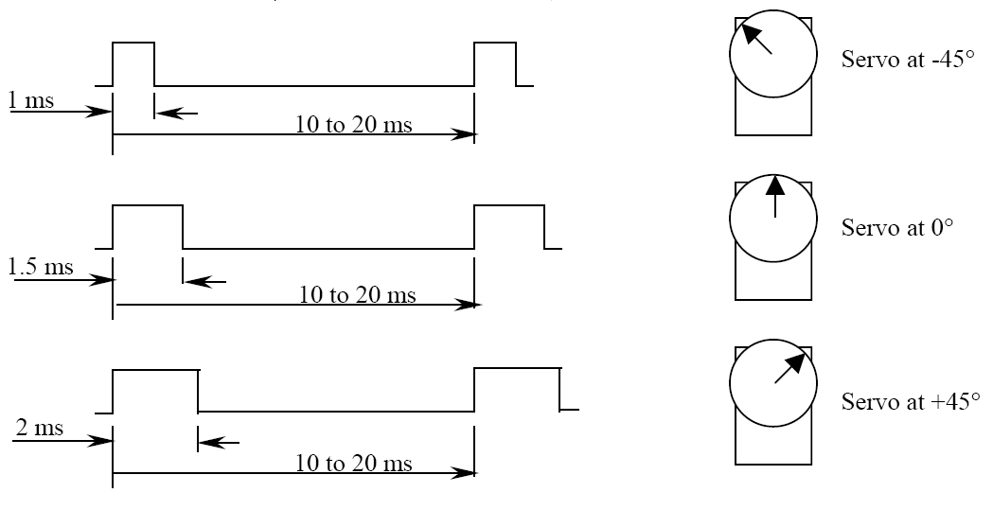

RC Servo
Construction
Operation
Wiring
Black is ground
Red is power
White/yellow is control
Arduino code
#include <servo.h>
Create a servo object
Attach the servo object to a pin
servo.write(position), where position is an integer between 0 and 180

Slide 14
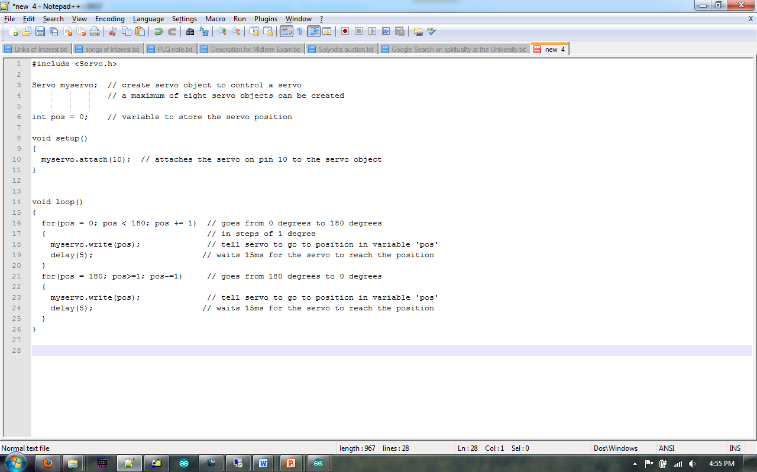
Servo_Sweep.pde

Slide 15
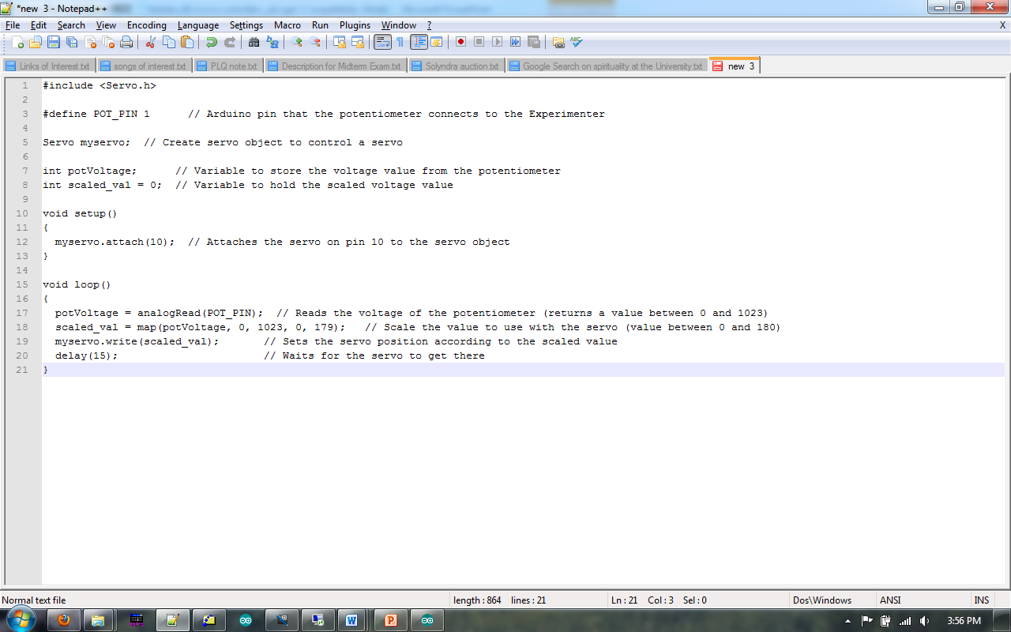
Servo Knob

Slide 16
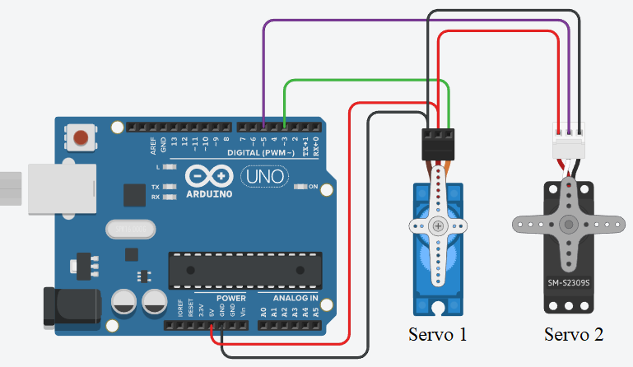
void loop()
{
// Rotating Servo motor 1 in Anti clockwise from 0 degree to 180 degree
for (position = 0; position <= 180; position++)
{
servo1.write(position); // Set position of Servo motor 1
delay(10);
}
// Rotating Servo motor 1 in clockwise from 180 degree to 0 degree
for (position = 180; position >= 0; position--)
{
servo1.write(position); // Set position of Servo motor 1
delay(15); // Short delay to control the speed
}
// Rotating Servo motor 2 in clockwise from 0 degree to 180 degree
for (position = 0; position <= 180; position++)
{
servo2.write(position); // Set position of Servo motor 2
delay(10); // Short delay to control the speed
}
// Rotating Servo motor 2 in Anti clockwise from 180 degree to 0 degree
for (position = 180; position >= 0; position--)
{
servo2.write(position); // Set position of Servo motor 2
delay(15); // Short delay to control the speed
} }
#include <Servo.h>
Servo servo1; // Create object for Servo motor 1
Servo servo2; // Create object for Servo motor 2
int position = 0; // Variable to store the position
void setup()
{
servo1.attach(3); // Set PWM pin 3 for Servo motor 1
servo2.attach(5); // Set PWM pin 5 for Servo motor 2
}

Slide 17
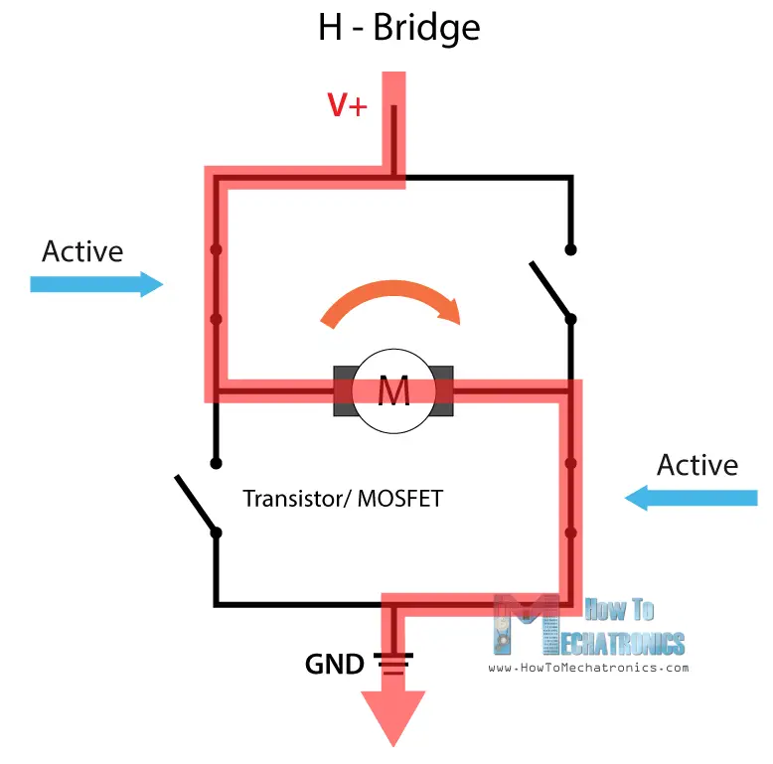
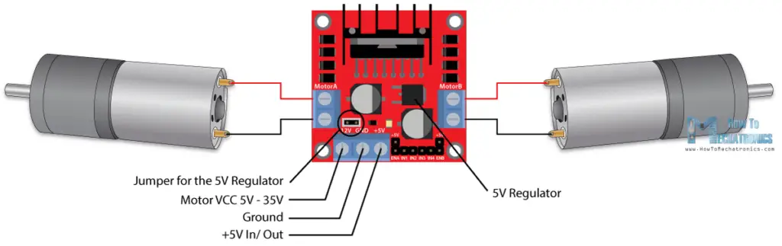
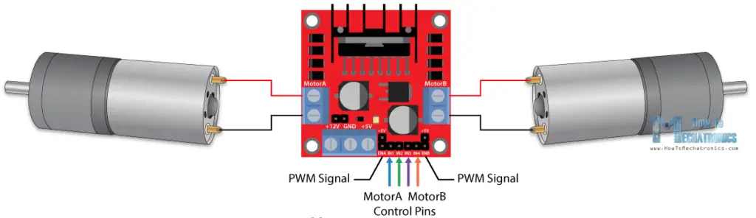
Robotics Car using DC Motor

Slide 18
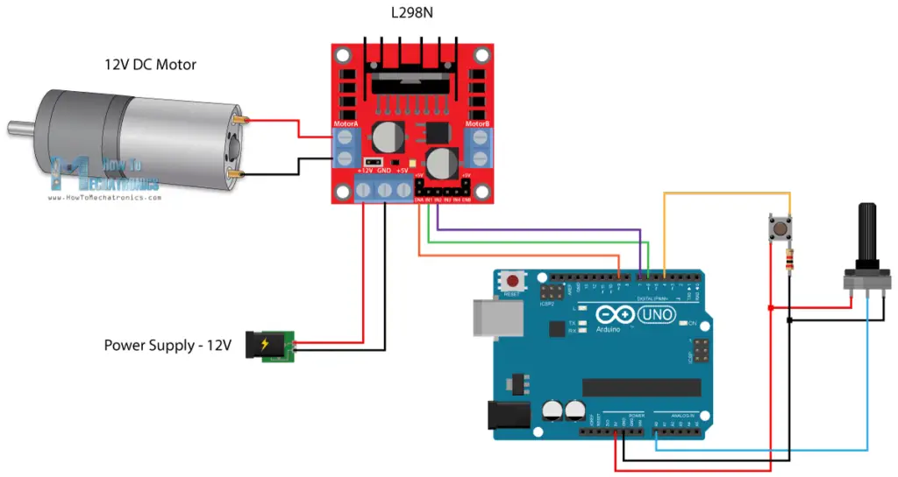
DC Motor speed Forward and Reverse direction

Slide 19
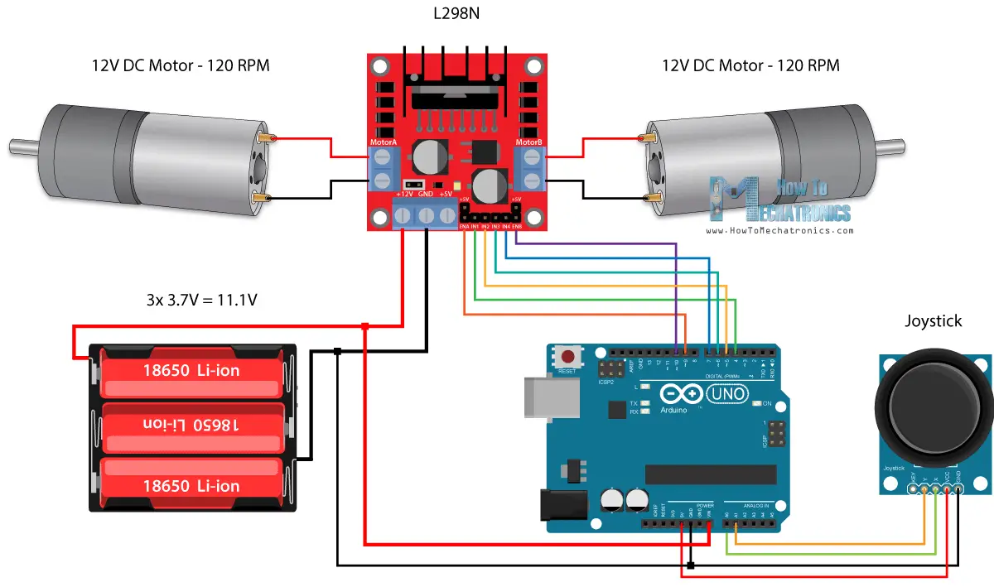
Car Moves using Joystick

Slide 20
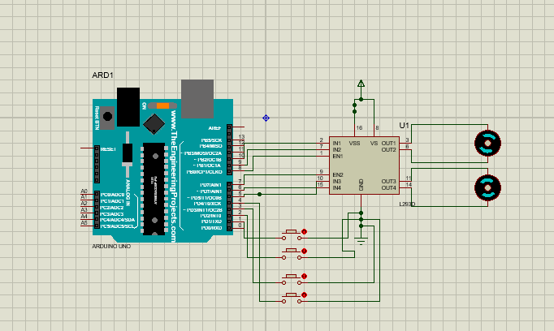

Slide 21
void setup() {
// Set up left motor pins
pinMode(leftMotorIn1, OUTPUT);
pinMode(leftMotorIn2, OUTPUT);
pinMode(leftMotorEn, OUTPUT);
// Set up right motor pins
pinMode(rightMotorIn1, OUTPUT);
pinMode(rightMotorIn2, OUTPUT);
pinMode(rightMotorEn, OUTPUT);
// Set up button pins
pinMode(forwardButton, INPUT_PULLUP);
pinMode(reverseButton, INPUT_PULLUP);
pinMode(leftButton, INPUT_PULLUP);
pinMode(rightButton, INPUT_PULLUP);
}
// Define motor control pins for left motor
int leftMotorIn1 = 10;
int leftMotorIn2 = 9;
int leftMotorEn = 8;
// Define motor control pins for right motor
int rightMotorIn1 = 6;
int rightMotorIn2 = 5;
int rightMotorEn = 7;
// Define button pins
int forwardButton = 1;
int reverseButton = 2;
int leftButton = 3;
int rightButton = 4;

Slide 22
void turnLeft() {
digitalWrite(leftMotorEn, HIGH);
digitalWrite(leftMotorIn1, LOW);
digitalWrite(leftMotorIn2, HIGH);
digitalWrite(rightMotorEn, HIGH);
digitalWrite(rightMotorIn1, HIGH);
digitalWrite(rightMotorIn2, LOW);
}
void turnRight() {
digitalWrite(leftMotorEn, HIGH);
digitalWrite(leftMotorIn1, HIGH);
digitalWrite(leftMotorIn2, LOW);
digitalWrite(rightMotorEn, HIGH);
digitalWrite(rightMotorIn1, LOW);
digitalWrite(rightMotorIn2, HIGH);
}
void stopMotors() {
digitalWrite(leftMotorEn, LOW);
digitalWrite(rightMotorEn, LOW);
}
void moveForward() {
digitalWrite(leftMotorEn, HIGH);
digitalWrite(leftMotorIn1, HIGH);
digitalWrite(leftMotorIn2, LOW);
digitalWrite(rightMotorEn, HIGH);
digitalWrite(rightMotorIn1, HIGH);
digitalWrite(rightMotorIn2, LOW);
}
void moveReverse() {
digitalWrite(leftMotorEn, HIGH);
digitalWrite(leftMotorIn1, LOW);
digitalWrite(leftMotorIn2, HIGH);
digitalWrite(rightMotorEn, HIGH);
digitalWrite(rightMotorIn1, LOW);
digitalWrite(rightMotorIn2, HIGH);
}

Slide 23
void loop() {
// Check the status of each button
if (digitalRead(forwardButton) == LOW) {
moveForward();
} else if (digitalRead(reverseButton) == LOW) {
moveReverse();
} else if (digitalRead(leftButton) == LOW) {
turnLeft();
} else if (digitalRead(rightButton) == LOW) {
turnRight();
} else {
stopMotors();
}
}

Slide 24
Practice Problem: Design a robot car using two DC motor in Proteous Circuit

Slide 25
Thank You!
25

